Slide 1


Fundamentals of RM
RM System and Process
Leadership in RM
Incident Investigation
RM Tools & Challenges
RM in Industry
People & Org.
Application and Perspectives
On Becoming a
Leader in Risk Management
ENGG404 - Lecture
Chapter 7.7: Leadership –
What Makes an Effective Leader?

Slide 2
Learning Outcomes:
Explain the difference between “managers and leaders”.
Explain the concept of “Leadership” in the context of risk management.
Explain and diagram “Our Personal Iceberg” Model, and why it is critically important that our actions are consistent with our intentions.
Begin a process to determine your personal values.
Analyse a basic scenario with alternative choices, and determine the values on which those choices are based.
Explain that good and effective leadership is founded on good values:
Explain how good characteristics and actions of leaders can positively influence the culture of an organization;
Explain the importance of the organization’s values, the leader’s values, the leader’s intentions, and the leader’s actions;
Explain that the leader’s actions must be consistent with their intention and values;
Explain the importance that the values of the leader must be congruent with the values of the organization.
Key Lesson: Leaders make positive things happen (in a principled manner) that would not have otherwise happened.
Chapter 7.7: Leadership – What Makes an Effective Leader?
2
Notes:
2

Slide 3
Q: What is Effective Leadership?
Significant study and experience condensed the vast topic of leadership:
  “Leadership is the use of power and influence to direct the activities of followers toward goal achievement.
  To accomplish this, a leader is entrusted with people and resources to add value to the business in a principled (legal, ethical, moral) way.
  A leader adds value by supporting their employees in a team or business unit so that they can do their jobs better.”
  Gord Winkel, 2013.
It could be further condensed as:
  “Leaders make positive things happen in a principled
  manner that would not have otherwise happened.”
Chapter 7.7: Leadership – What Makes an Effective Leader?
3
Notes:
3

Slide 4
Comparison of Managers and Leaders – Risk Management:
Managing safety provides a solid basis for an organization to achieve compliance, but an emphasis on leadership is needed to achieve significantly higher levels of safety & business performance.
Managers | Leaders
Focus on systems, processes, programs, and the “status quo” (maintain performance) | Focus on people, change for the good of the organization, and the future
Organizations seen as machines | Organizations seen as living systems: complex, adapting, self-organizing networks of people
Value reliability, stability, predictability, and control | Value the open flow of information, building trust, and sense of belonging (meaning),
Needed for linear, step-by-step processes (e.g. payroll, production schedules, human resources procedures) to keep things running | Takes on new challenges; sees continuous improvement as a core function. Require courage, care, concern, & commitment.
Supervising, directing, problem solving, leader-directed teams | Engages and empowers people; enables and promotes self-directed teams
Chapter 7.7: Leadership – What Makes an Effective Leader?
4
Notes:
4

Slide 5
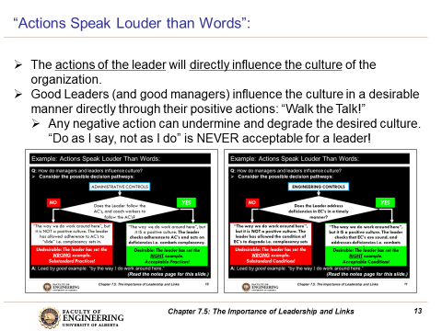
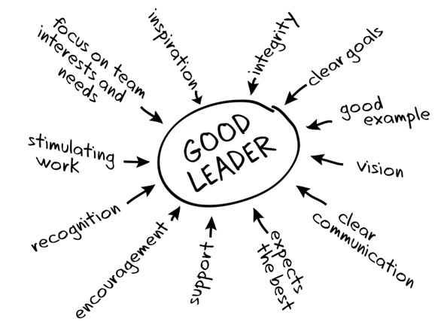
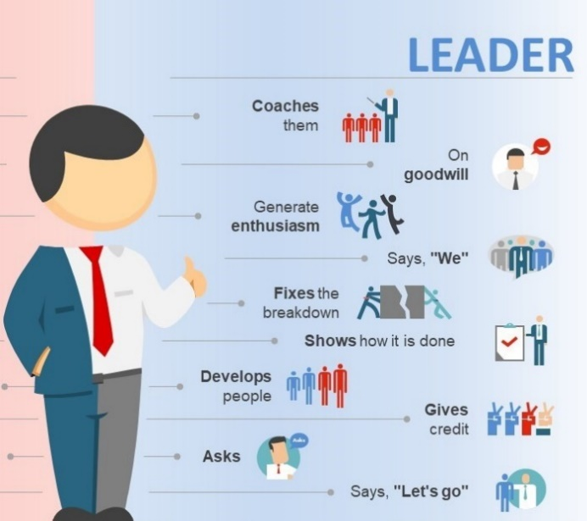
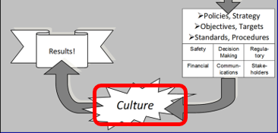
The Characteristics of Good Leaders:
Leaders shape and influence the culture of their organization for optimum performance and benefit of the organization.
Chapter 7.7: Leadership – What Makes an Effective Leader?
5
Notes:
5

Slide 6
The Characteristics of Good Leaders:
Provides leadership
Commits to the RMP
Effectively implements the RMP
Clearly defines responsibilities
Effectively allocates resources – people & funds
Sets expectations for performance
Critiques performance effectively
Provides recognition for good work
Holds people accountable
Translates the vision into culture
Has a working knowledge of tasks and activities
Chapter 7.7: Leadership – What Makes an Effective Leader?
6
Notes:
6

Slide 7
Consider: Are Leaders “Born” or “Made”?
Recall:
Safety culture is determined by the actions of leaders!
The leaders actions (practices, behaviours) are the strongest form of messaging.
Two theories of the “making” of effective leaders have evolved:
Trait-based models – “leaders are born”.
Behaviour-based models – “people can be trained to be good leaders”.
Think of any “leaders” you know or for whom you worked in your work terms. What was your perspective of those leaders? Were they:
  “Born leaders?”
  “Trained leaders?”
Research, beginning well over 50 years ago, supports that leaders can be trained. This lecture aims to explore these universal questions:
  What is leadership? Effective leadership?
  What makes a great leader?
  Why does it matter?
Chapter 7.7: Leadership – What Makes an Effective Leader?
7
Notes:
7

Slide 8
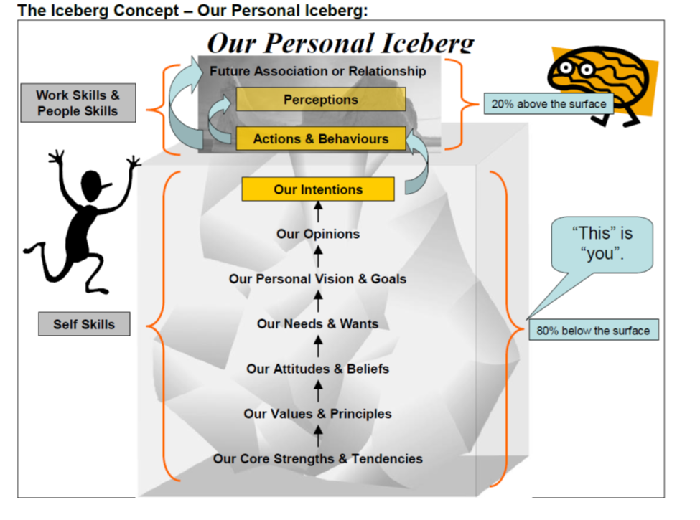
Our Personal Iceberg:
1) This is what people “see about you”.
2) People “form perceptions about you”.
Chapter 7.7: Leadership – What Makes an Effective Leader?
8
Notes:
8
People – your superiors, your peers, and your subordinates – see your actions and your behaviours.
They cannot know what you are thinking, or know any of the underlying opinions, goals, needs and wants, attitudes, values and principles, and core strengths – unless you explicitly inform them! And that would take a lot of time and effort, not only because there is a lot to communicate in a clear and succinct terms, but also because we have a difficult time determining, defining, refining, and articulating the same list!
Because they cannot know, it is critically important for us in our leadership role to ensure that our actions and behaviours are exactly aligned with our intentions.

Slide 9
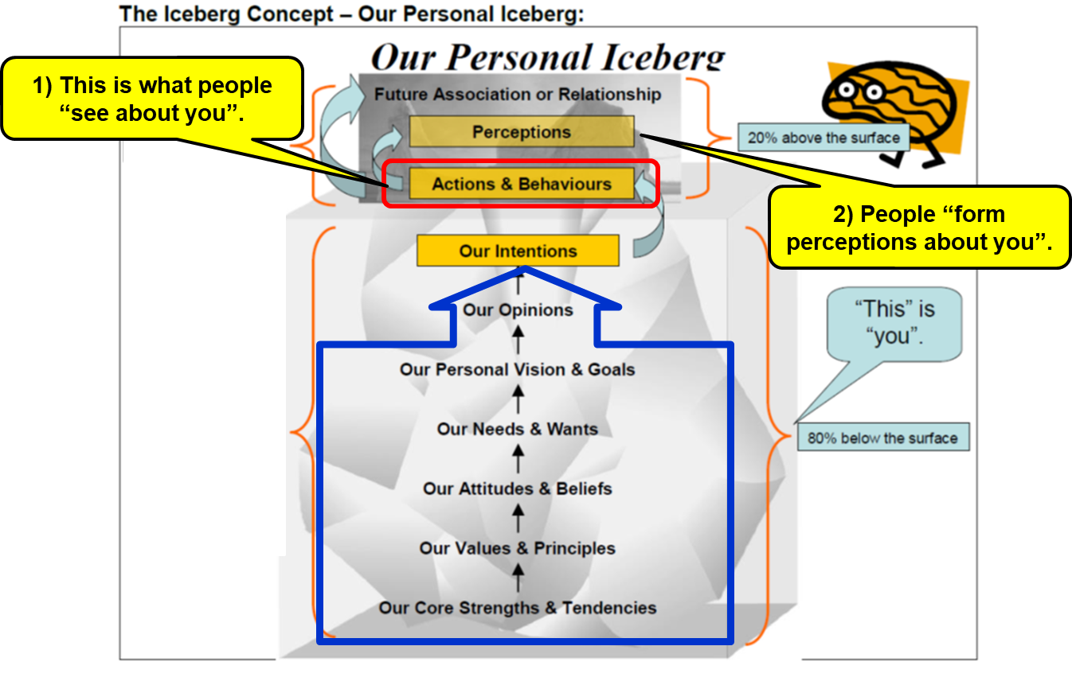
Our “Personal Iceberg Model” and Effective Leadership:
People – your superiors, your peers, and your subordinates – see your actions and your behaviours.
  This is “their perception of you” or “how they perceive you”.
They cannot know what you are thinking, nor do they know any of your underlying opinions, goals, needs and wants, attitudes, values and principles, and core strengths – unless you explicitly inform them!
  And that would take a lot of time and effort, not only because there is a lot to communicate in clear and succinct terms, but also because we have a difficult time determining,
  defining, refining, and articulating
  the same list about ourselves!
Because they cannot know, it is
critically important for us in our
leadership role to ensure that our
actions and behaviours are exactly
aligned and consistent with our
good intentions.
Chapter 7.7: Leadership – What Makes an Effective Leader?
9
Notes:
9

Slide 10
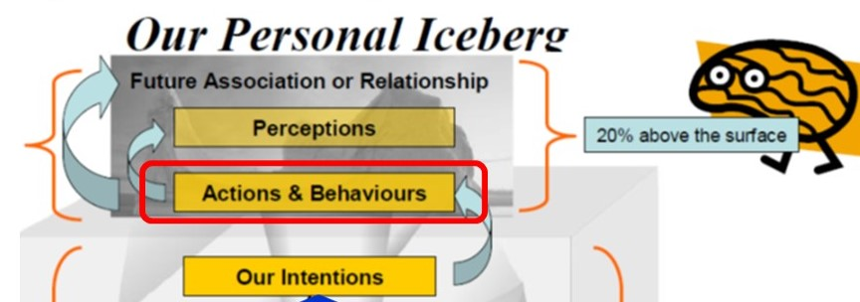
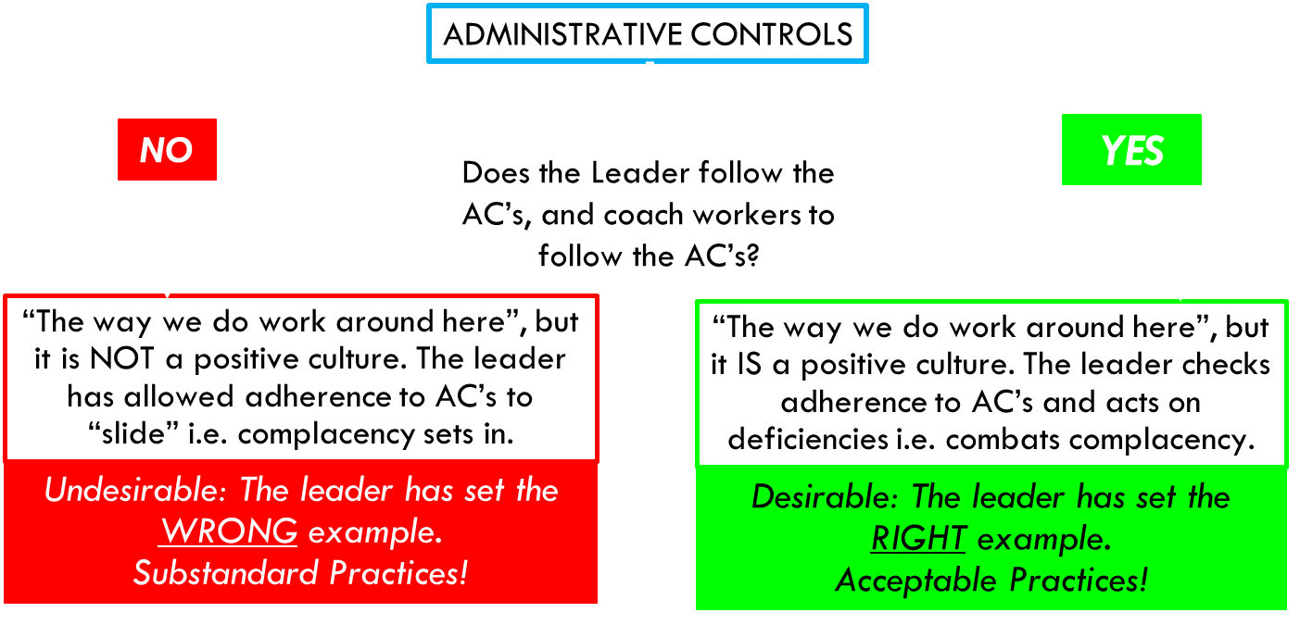

Our “Personal Iceberg Model” and Effective Leadership:
This is the desired state!
1) If our intentions ARE manifested in our actions & behaviours;
2) Then people will see you for what your actions and behaviours are, AND your ACTUAL intentions!
3) IF our actions and
behaviours are perceived
as positive or desirable,
THEN we are shaping the
desired culture AND
we ARE effective leaders!
Chapter 7.7: Leadership – What Makes an Effective Leader?
10
Notes:
10

Slide 11
ALE #1: Our “Personal Iceberg Model” & Effective Leadership:
Please confer: How would you complete sentence #3? (Open discussion)
1) If our intentions are NOT manifested in our actions & behaviours;
2) Then people will see you for what your actions and behaviours are, and NOT your intentions!
3) So, regardless of our good
intentions, IF our actions and
behaviours are perceived
as negative or undesirable,
THEN ____________ AND
________________________!
Chapter 7.7: Leadership – What Makes an Effective Leader?
11
Notes:
11

Slide 12
Our “Personal Iceberg Model” and Effective Leadership:
Therefore, it becomes critically important for us to ensure that our actions & behaviours are exactly aligned & consistent with our good intentions!
1) If our intentions are NOT manifested in our actions & behaviours;
2) Then people will see you for what your actions and behaviours are, and NOT your intentions!
3) So, regardless of our good
intentions, IF our actions and
behaviours are perceived
as negative or undesirable,
THEN we are not shaping the
desired culture AND
we ARE NOT effective leaders!
Chapter 7.7: Leadership – What Makes an Effective Leader?
12
Notes:
12

Slide 13
Our “Personal Iceberg Model” and Effective Leadership:
Your intentions and an opportunity for self-reflection.
Do you recall any situation … when others’ perceptions of you were different than your intentions?
1) If our intentions are NOT manifested in our actions & behaviours;
2) Then people will see you for what your actions and behaviours are, and NOT your intentions!
Chapter 7.7: Leadership – What Makes an Effective Leader?
13
Notes:
13

Slide 14
Our “Personal Iceberg Model” and Effective Leadership:
“I passed by three of my students sitting at a table in the Food Court in a previous term, and gave them a very meek nod. Perhaps so meek that they did not see it. I did see them, and they did see me looking at them, so it was not as though I did not see them. Later, it occurred to me that perhaps I appeared uninterested in them, or that I was in too much of a rush to say hello to them, or worse, that I did not care about them. Indeed, it was not my intention to come across in such bad light but that is how they could perceive my behaviour. In fact, I was somewhat embarrassed as I could recall two of their names, but not able to assign names to faces nor recall the third name. I failed in “professional courtesy”. So, I was determined to set this right. The very next time I saw those students in class, I purposely went up to them, introduced myself in our way, and then apologized to them for not stopping to say “hello” earlier in the week.
1) If our intentions are NOT manifested in our actions & behaviours;
2) Then people will see you for what your actions and behaviours are, and NOT your intentions!
Chapter 7.7: Leadership – What Makes an Effective Leader?
14
Notes:
14
Here, the professor can relate a simple example, such as:
“I passed by three of my students sitting at a table in the Food Court earlier in the week with a very meek nod. Perhaps so meek that they did not see it. I did see them, and they did see me looking at them, so it was not as though I did not see them. I occurred to me after that perhaps I appeared uninterested in them, or that I was in too much of a rush to say hello to them, or worse that I did not care about them. Indeed, it was not my intention to come across in such bad light. In fact, I was somewhat embarrassed as I could recall two of their names, but not able to recall correctly nor recall the third person. I failed in “being professional” with my manners. So, I wasa determined to set this right. The very next time I saw those students in class, I purposely went up to them, introduced myself in our way, and then apologized to them for not stopping to say “hello” earlier in the week. AS a matter of fact, I used this example along with an explanation for this same topic!”

Slide 15
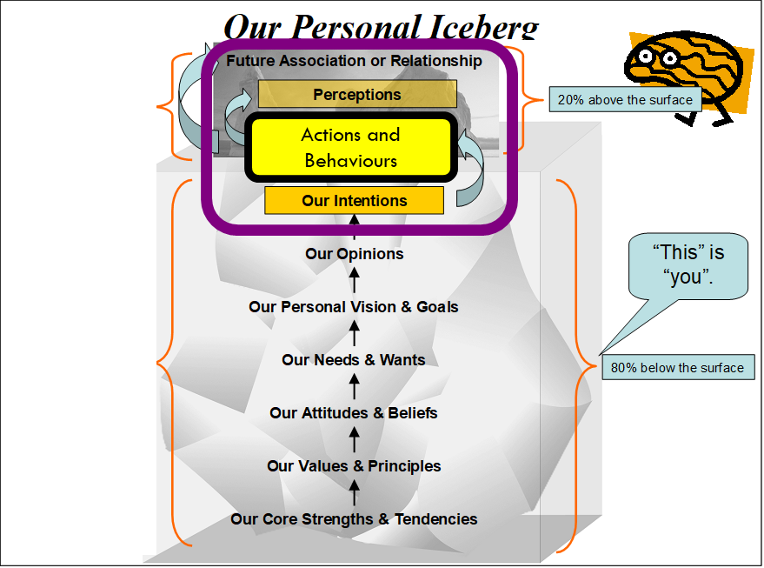
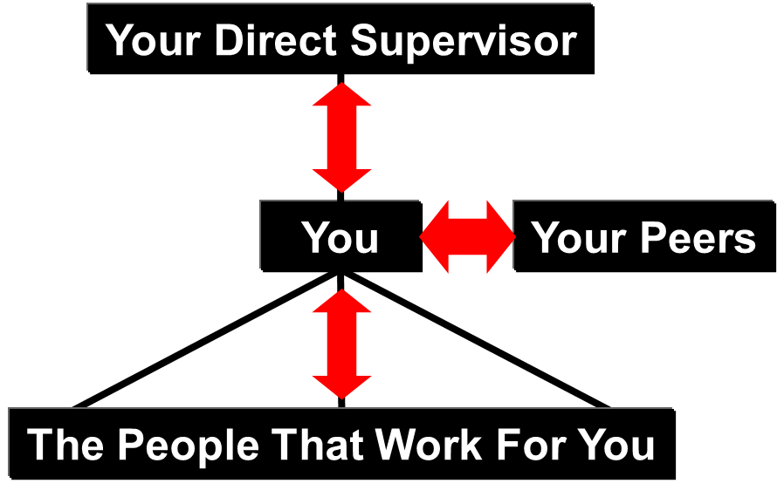
Our “Personal Iceberg Model” and Effective Leadership:
The Golden Rule for all relationships:
Dignity, respect, and integrity in your interactions with your supervisors, peers, and subordinates are essential for building and maintaining effective relationships.
“Treat others like you want to be treated.”
Chapter 7.7: Leadership – What Makes an Effective Leader?
15
Notes:
15

Slide 16
What are Values? What are Your Values?
From Our Personal Iceberg discussions, “We are who we are” is a result of the values (and attitudes, and so on) that we have developed early in our lives, and as we purposefully change our values as we grow, adapt, and mature.
These values become the basis for how we prioritize, for how we
make decisions, for “how we do work around here”.
Depending on our period of life experience, these values (and other dimensions) may be influenced very differently, and they share prevailing paradigms in society and the workplace.
Chapter 7.7: Leadership – What Makes an Effective Leader?
16
Notes:
16

Slide 17
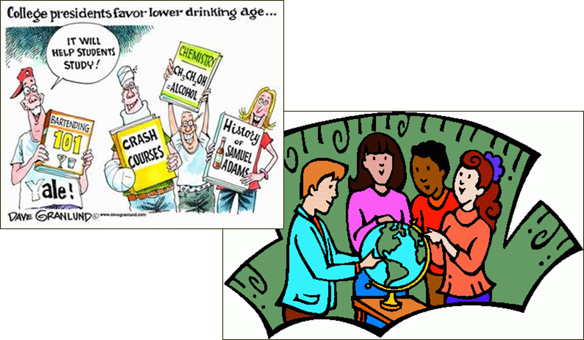
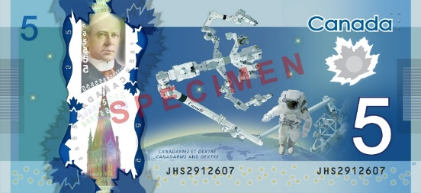
What are Values? What are Your Values?
Values:
1) Determine or set your priorities …
2) Are the basis on which you make decisions …
The discussion about
two study groups:
Values of the left vs.
those of the right?
… the discussion about the Professor
walking through the ETLC and finding
a $5 bill on the floor?
Chapter 7.7: Leadership – What Makes an Effective Leader?
17
Notes:
17

Slide 18

ALE #2: What are Your Values?
Open discussion: The $5 bill and two scenarios:
Scenario 1) The professor is walking through the empty Food Court early in the morning and sees a $5 on the floor. What does the professor do? On what value(s) are each of these choices based?
Scenario 2) The professor is walking through the busy Food Court. The professor observes a student pull out their cell-phone from their pocket, and unbeknownst to the student, a $5 bill falls onto the floor. What does the professor do? What choices does the professor have? On what values are each of these choices based?
Chapter 7.7: Leadership – What Makes an Effective Leader?
18
Notes:
18
The discussion about the $5 bill and two scenarios:
Scenario 1) The professor is walking through the empty Food Court early in the morning and sees a $5 on the floor. What does the professor do? The professor actively looks for someone, but seeing as no one is around and there is not even a remote possibility of looking the rightful owner of the $5, the professor pockets the money … and likely with the intention of donating it to one of the campus charities. What value(s) did the professor exhibit? Values: Rightful ownership, generosity, charity.
Scenario 2) The professor is walking through the busy Food Court. The professor observes a student pull out their cell-phone from their pocket, and unbeknownst to the student, a $5 bill falls onto the floor. What does the professor do? What choices does the professor have? 1) Quietly and quickly scope up and keep the $5. 2) Pick it up and contact the student to return the $5. On what values are each of these choices based? 1) Greed. Lack of ethics. “Finders keepers, losers weepers.” Lack of integrity – if the professor claims to be honest, but does not demonstrate it. 2) Honesty. Rightful ownership of property. Integrity – living by their good values.

Slide 19
What are Values? What are Your Values?
Discussion: The $5 bill and two scenarios:
Scenario 1) The professor is walking through the empty Food Court early in the morning and sees a $5 on the floor. What does the professor do? On what value(s) are each of these choices based?
The professor actively looks for someone, but seeing as no one is around and there is not even a remote possibility of finding the rightful owner of the $5, the professor pockets the money for either 1) a fresh coffee, or 2) donate to a campus charity.
Scenario 2) The professor is walking through the busy Food Court. The professor observes a student pull out their cell-phone from their pocket, and unbeknownst to the student, a $5 bill falls onto the floor. What does the professor do? What choices does the professor have? On what values are each of these choices based?
The professor quickly scoops up and keeps the $5.
The professor picks it up and contacts the student to return the $5.
Chapter 7.7: Leadership – What Makes an Effective Leader?
19
Notes:
19
The discussion about the $5 bill and two scenarios:
Scenario 1) The professor is walking through the empty Food Court early in the morning and sees a $5 on the floor. What does the professor do? The professor actively looks for someone, but seeing as no one is around and there is not even a remote possibility of looking the rightful owner of the $5, the professor pockets the money … and likely with the intention of donating it to one of the campus charities. What value(s) did the professor exhibit? Values: Rightful ownership, generosity, charity.
Scenario 2) The professor is walking through the busy Food Court. The professor observes a student pull out their cell-phone from their pocket, and unbeknownst to the student, a $5 bill falls onto the floor. What does the professor do? What choices does the professor have? 1) Quietly and quickly scope up and keep the $5. 2) Pick it up and contact the student to return the $5. On what values are each of these choices based? 1) Greed. Lack of ethics. “Finders keepers, losers weepers.” Lack of integrity – if the professor claims to be honest, but does not demonstrate it. 2) Honesty. Rightful ownership of property. Integrity – living by their good values.

Slide 20
What are Values? What are Your Values?
Summary of Choices Based on Values:
Scenario 1 Options | Scenario 2 Options
Buy fresh coffee: Rightful ownership (attempt) | Pocket the $5: Greed. Dishonest. Lack of integrity
Buy their colleague a coffee Generosity | Return the $5 to the student: Honesty. Rightful ownership of property. Integrity – living by their values.
Donate to Charity Charity | Other choice: Keep the money and then give to charity. This example explores the phase “Does the ends justify the means?” Delivered on a positive value, charity, but based on a negative value, dishonesty.
Chapter 7.7: Leadership – What Makes an Effective Leader?
20
Notes:
20
The discussion about the $5 bill and two scenarios:
Scenario 1) The professor is walking through the empty Food Court early in the morning and sees a $5 on the floor. What does the professor do? The professor actively looks for someone, but seeing as no one is around and there is not even a remote possibility of looking the rightful owner of the $5, the professor pockets the money … and likely with the intention of donating it to one of the campus charities. What value(s) did the professor exhibit? Values: Rightful ownership, generosity, charity.
Scenario 2) The professor is walking through the busy Food Court. The professor observes a student pull out their cell-phone from their pocket, and unbeknownst to the student, a $5 bill falls onto the floor. What does the professor do? What choices does the professor have? 1) Quietly and quickly scope up and keep the $5. 2) Pick it up and contact the student to return the $5. On what values are each of these choices based? 1) Greed. Dishonest. “Finders keepers, losers weepers.” Lack of integrity – if the professor claims to be honest, but does not demonstrate it. 2) Honesty. Rightful ownership of property. Integrity – living by their good values.

Slide 21
What are Values? What are Your Values?
Side discussion:
Scenario 1 Options | Scenario 2 Options
Buy fresh coffee: Rightful ownership (attempt) | Pocket the $5: Greed. Dishonest. Lack of integrity, especially if the Professor teaches ethics!
Some people can, and should, be held to a higher standard.
Chapter 7.7: Leadership – What Makes an Effective Leader?
21
Notes:
21
A professor who teaches ethics should know the right action to take, the right thing to do, and their credibility is based not on what they say or teach, but what their actions “say”.

Slide 22
What are Values? What are Your Values?
Deep down, values are probably the measures you use
to tell if your life is turning out the way you want it to.
When the things that you do and the way you behave match your values, life is usually good – you're satisfied and content.
But when these don't align with your values, that's when things feel... wrong. This can be a real source of unhappiness.
This is why making a conscious effort to identify your values
is so important.
Take some time in your career to develop and
crystallize YOUR values!
Chapter 7.7: Leadership – What Makes an Effective Leader?
22
Notes:
22

Slide 23
Good Leadership Is Founded On Good Values:
Values are essential for effective leadership, for the good of the organization and the workers.
Leaders promote values that have meaning for team
members and will encourage norms of safe behaviour.
Typical Values Set of a Team:
Professional Excellence
Accountability
Collaboration
Empowerment
Commitment
Innovation
Integrity
Initiative
Leadership
Respect
Consistency
Community i.e. “Togetherness”
Typical Values Set of a Student:
Academic Excellence
Balance in Work and Life
Mental / Psychological Health
Physical Fitness / Fun/Recreation
Collaboration
Commitment
Innovation
Integrity
Initiative
Leadership
Respect
Ambition
Chapter 7.7: Leadership – What Makes an Effective Leader?
23
Notes:
23

Slide 24
Core Values of an Organization:
The 5 Core Values that Every Organization Should Have; Jessica Simms; CareerMetis.com; https://careermetis.com/organization-core-values/
Organizations (any kind of organization, from small community groups to multi-national corporations) that embrace these five core values are more likely to succeed in the long-term.
I would add COMMITMENT
Transparency
Accountability
Empathy
Respect
Continuous Improvement
And many great leaders will “test” for your commitment before asking you to join their team!
Chapter 7.7: Leadership – What Makes an Effective Leader?
24
Notes:
24

Slide 25
The Personal Iceberg, Effective Leaders, and Their Values:
To reach desired performance, the Leader must shape the desired culture.
The leader’s values shape the culture by providing the foundation for ‘who we are’ and ‘how we do things around here’.
Because the organization strives for the desired performance, people are assigned to leadership roles to shape the desired culture.
To shape the desired culture, leader’s must set the example through their actions and behaviours i.e. “Lead by Example” and “Walk the Talk”.
The leader’s actions must be consistent with their intentions, and …
The leader’s intentions are founded on values!
Chapter 7.7: Leadership – What Makes an Effective Leader?
25
Notes:
25

Slide 26
Congruence: Leader’s Values and the Organization’s Values:
Organizational performance and culture are founded on leadership values.
People are assigned to leadership roles to shape the desired culture.
Thus; there must be congruence between the leader’s values and the organization’s values!
    Without congruence, the leader will fail and the organization will suffer a set-back.
Therefore, the Leader must understand their own values and those of the organization that, ideally, are aligned and serve as the standards for others.
    So they are not in conflict with themselves;
    So they can sincerely uphold the values in the organization; and
    Which enables the leader to live the values and thereby set the example.
    Congruence is a key factor in being an effective leader!
Chapter 7.7: Leadership – What Makes an Effective Leader?
26
Notes:
26

Slide 27
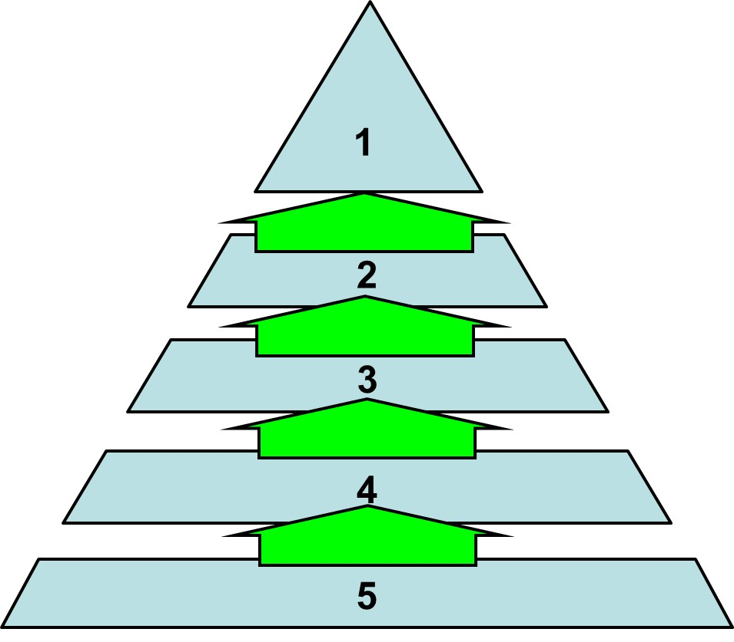
ALE #3: Can you construct this model?
Please confer and respond (MM-Rank):
Pre-test: Can you construct this model i.e. what is the order or relationship of these concepts?
Leadership Actions
Culture
Leadership Intentions
Performance
Leadership Values
Chapter 7.7: Leadership – What Makes an Effective Leader?
27
Notes:
27

Slide 28
The Effective Leader Sets the Foundation for Performance:
The drivers of safety performance are culture,
leadership actions, and leadership intentions.
It follows that Performance is founded
on Leadership Values!
Leading organizations clearly see that
performance depends not just on the
culture of the organization, but goes
much deeper down to shaping the
values of those persons in
leadership roles and the values
of the organization.
And that there must be
congruence between each
individual leader’s values
and the values of the
organization.
Performance
Culture
Leadership Actions
Leadership Intentions
Leadership Values
(and Principles, Goals, Attitudes, etc.)
Chapter 7.7: Leadership – What Makes an Effective Leader?
28
Notes:
28

Slide 29
Summary and Key Lessons:
Leaders make positive things happen (in a principled manner) that would not have otherwise happened.
To be effective leaders, our actions and behaviours must be consistent with our intentions, which are founded upon our values and our organization’s values.
  Dignity, respect, and integrity in your interactions with others are essential for building and maintaining effective relationships.
  “Treat others like you want to be treated.”
Decisions are based and prioritized on values.
  Your values are what you believe are important about the way you live and work.
  Your organization’s values are what the most senior leadership believes are important about the way the organization operates.
  The congruence of good values are essential to effective leadership … for the good of the organization and the workers.
Chapter 7.7: Leadership – What Makes an Effective Leader?
29
Notes:
29

Slide 30
Any questions?
Notes:
30

